Slide 1

What is time management?(TM)
Time Management refers to managing time effectively so that the right time is allocated to the right activity.

Slide 2
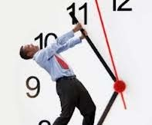
Why do we need TM ?
To save time
To reduce stress
To function effectively
To increase our work output
To have more control over our job responsibilities.

Slide 3
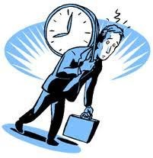
How to use time effectively?
Effective Planning
Setting goals and objectives
Setting deadlines
Delegation of responsibilities
Prioritizing activities as per their importance
Spending the right time on the right activity

Slide 4
The process of TM starts with-
Cost your time
Making activity logs
Goal setting
Planning
Prioritizing
Scheduling

Slide 5
Costing your time
Understand your true value by calculating your
cost per year
Cost per year = (Salary + taxes + office space + office
equipment + profit you generate)
Calculate your hourly rate =Cost per year / work hr per year
…know where you stand

Slide 6
Making activity logs
Help in
Make a realistic estimate of the time spend during the day on job orders
Pinpoint the critical areas:- time spend on low value jobs
Finding the high yielding time of our day

Slide 7
Goal setting
Setting lifetime goals help you to chart your life course & your career path
Breakup your lifetime goal in smaller goals
Make a daily TO-DO list
Revise and update your list on daily bases & judge your performance

Slide 8
Planning
Draw an action plan-
A list of things that need to be done to achieve your goals

Slide 9
Prioritizing
Make a TO- DO list
Consider the value of the task before to do it-
Is it worth spending your time and company resources
Prioritize your task-
The most important jobs should be completed first followed by other jobs

Slide 10
Scheduling
Make a realistic estimate of how much you can do
Plan to make the best use of the available time
Preserve some contingency time to deal with ‘unexpected jobs’
Minimize stress by avoiding over- commitment by yourself and others.

Slide 11
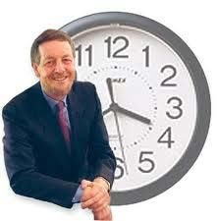
Achieve your goals
Be your own judge and your own motivator,
Make Time Management your tool for success.

Slide 12
Use your time wisely
Time is what we want most, but what we use worst.
William Penn
The common man is not concerned about the passage of time, the man of talent is driven by it. Schopenhauer
The key is in not spending time, but in investing it.
Stephen R. Covey
Make use of time, let not advantage slip.
William Shakespeare

Slide 13
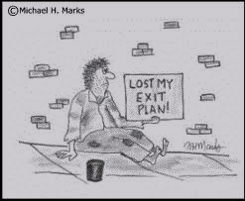
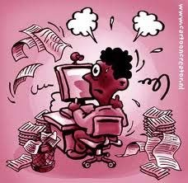
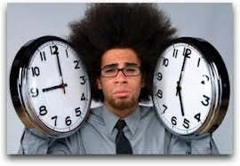
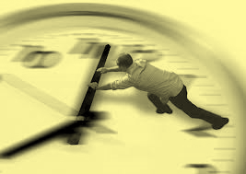
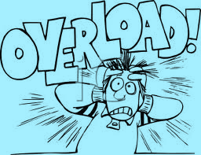
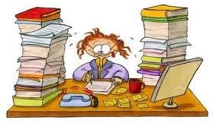
Situation become odd…

Slide 14

Manage your time & keep smiling…

Slide 15

Question ???

